Slide 1

Data Sharing Update
2022

Slide 2
Contents
DSP Toolkit
Online Access
Proxy Access
Access for children
Deceased records
National Data Opt Out

Slide 3
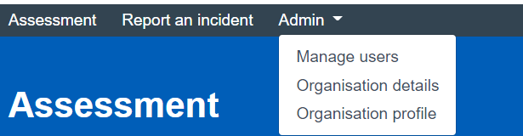
DSP Toolkit - Reminder
Final date to publish 30th June 2022
5.1.1 Staff training must be completed between 1 July 2021 and 30th June 2022
Check the practice profile and users – update if necessary.
If your Caldicott Guardian or SIRO have changed you need to update this on the CG and SIRO register https://digital.nhs.uk/services/organisation-data-service/update-your-data/registers
There is no requirement to answer the non-mandatory questions, but you can if you wish, and are able – they may be mandatory next year.
It is up to you if you upload documents to the toolkit – add a link to your website for the privacy notice – but make sure that the privacy notice is up to date.

Slide 4
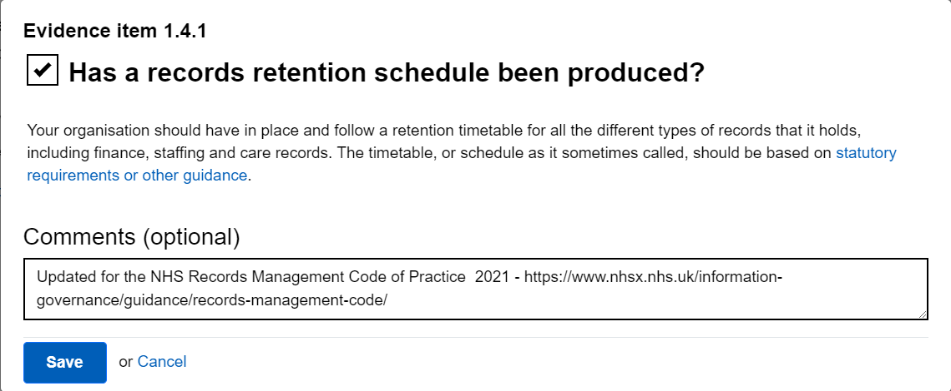
DSP Toolkit – Hints and Tips
Do not assume that last years answer is correct now – check before confirming the assertion is correct.
Add information to the comment box – this may be helpful for the person completing your toolkit next year.

Slide 5
DSP Toolkit – Hints and Tips
1.3.2 – Do you carry out regular spot checks? Use a checklist and log any actions.
3.2.1 – 95% of staff to have completed training since 1st July 2021.
The training should be DSP Level 1, through eLfH, Bluestream or another online service but must have an assessment at the end. Staff on long term sick or maternity leave do not need to be counted.
4.3.1 Administrators signing a privileged access agreement – this is for the IT staff who act as administrators for the clinical or other systems, not all staff.
10.2.1 IT system suppliers have cyber security certification – if your previous comment is about Gpsoc – this has now changed to GPIT Futures https://digital.nhs.uk/services/gp-it-futures-systems

Slide 6
Online Access
Online access has been part of the GMS contract for a number of years. It gives the patient online access to their own information and forms part of the NHS Forward Plan.
It gives patients access to their own medical record.
April 2016 - Online access to coded information to be promoted and offered.
April 2019 – online access to the full prospective record for all newly registered patients.
April 2020 – all patients must be offered online access to all prospective data, and retrospective access on request.
Summer 2022 – full prospective access will be turned on for all practices using Emis or Systmone.
Notes:
Online access gives patients access to their own records.

Slide 7
From Summer 2022
FULL prospective online access to records.
Does not include:
Tasks
Admin notes and alerts
Unfiled results
Information “redacted” by the practice.
Third party information
Child protection, safeguarding, police, insurance, MASH or MARAC reports
Information considered to be harmful to the patient.
For patients with existing online access or NHS App
For all new patients registering for online access or the NHS App

Slide 8
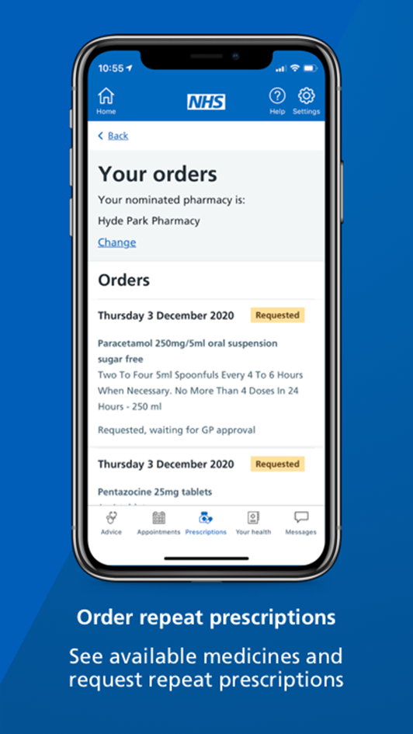
NHS App
Available to patients aged 13 and over.
All ID verification is carried out on the mobile phone.
Gives instant access to patient online data as set up by the practice.
Book appointments
Order medication
View health record
Get health advice
Covid pass
Gives NHS number.
www.nhs.uk/nhs-app

Slide 9

Considerations
Entries should be redacted at the time they are entered.
Care should be take in the wording used for free text, is it clear and easy to understand.
Avoid abbreviations or acronyms if possible.
Only the entire consultation can be redacted. If adding “Next Problem” in Emis they cannot be split to only one problem being redacted – complete a 2nd consultation.
When Docman documents are received they are provisionally filed, and not visible online. Once filed they become visible, in Docman > Workflow > Actions choose “prevent viewing of this document”
Test results will not be visible until filed by a clinician.
Entries can be redacted from within Care History – R-click and “do not display” from online visibility.
The entry will show

Slide 10
Redacting from online view - EMIS
Before you File a consultation click the “online Visibility” button on the top toolbar and choose “Do not display on the patient’s online care record”
Or Right click on any coded entry/ consultation and select “Online visibility”

Slide 11

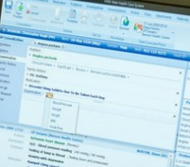
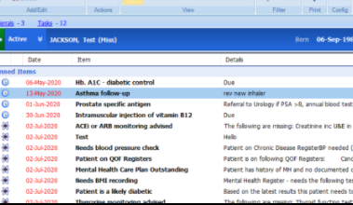
In Emis Entries CAN be redacted…
When filing a document
From Consultations
From Care History
Entries cannot be redacted from:
Documents
Investigations
Referrals
Problems
Diary

Slide 12
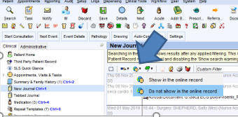

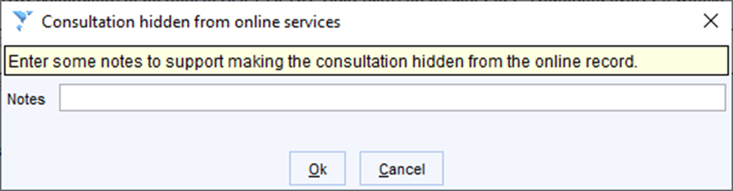
Redacting from online view - Systmone
From the Patient’s Journal
Highlight the entry to be redacted
Click on the icon
Select –”Do not show in online record”

Slide 13
Other points
If online access could be detrimental to a patient, it can be removed from an individual – for example in a patient with dementia or severe mental health issues.
Historic online record access can be given. The patient should request this as and the record checked and redacted as for a SAR, but there is no requirement to give access to free text, or documents in any records prior to 2019.
Digitalised Lloyd George records do not need to be included in online access.
Warning – entries “redacted” will become visible again after a record is transferred via GP2GP – add the Snomed code 1364731000000104 Enhanced review indicated before granting access to your own health record

Slide 14
Corrections to records
Patients can ask for records to be corrected.
Only information which is factually incorrect can be changed – ie. a letter not related to the current patient should be removed.
If a clinician has added an opinion or diagnosis which the patient disagrees with it should not be removed but annotated with the patient’s opinion.

Slide 15
Proxy Access
Proxy access allows a patient to consent to another person having limited access to their medical record – for example carers, parents or care home staff.
The changes to online access do not apply to Proxy Access.
It does not give full access to the records, but the practice can allocate access such as medications, appointments, test results according to the patients needs.
Proxy Access is available for parents of children under 12, and on a case by case basis after this age.

Slide 16
Children’s records.
Parents can request copies of children’s records up to the age of 13 years.
Proxy access is stopped by the clinical system when they are 11 years old.
A clinician can declare a child Gillick competent to manage their own health information and care – this must be recorded on the child’s record.
You are not committing a breach if the child asks you to not disclose information to the parent.
From 13 years:
At 13 the teenager can have the NHS App – they obtain their login from the practice so that they can check their ID.
Consideration should be given to coercion – you can refuse to give access if you feel the child is being forces to get access or give consent
The teenager should be asked for consent to share their information – even with their parents
Children who are competent have the right to be treated without the knowledge of their parents.

Slide 17
Children’s records.
Separated Parents
You should confirm parental responsibility and proof of ID with the parent requesting access or information
The father can prove parental responsibility by either being named on the birth certificate or married to the mother when the child was born.
Parents may be awarded responsibility by the courts
The “other” parent cannot prevent you sharing the information, but you may want to check that there is no legal order preventing you from providing some or all of the required data
Warning
The parent may not know where the child is living – extra care must be taken and contact details may need to be redacted.
There have been incidents of child’s information being shared with a parent who did not know the address and it has led to arrests when the father has tried to “snatch” the child.

Slide 18
Deceased patients.
UK GDPR and DPA only apply to living individuals.
Deceased patient records are protected by Section 8 Access to Health Records Act 1990
Executors of the estate or persons holding letters of administration can request information from the patients record. – not a SAR
Persons with a claim arising from the death – eg an insurance claim, dispute over the patients capacity when the will was signed etc. – only information related specifically to the claim.
Confidentiality and patients wishes continue after their death
E.g. if a patient requested that information was not shared with their family before their death, then this continues to apply after death.
“Next of Kin” has no legal basis for obtaining information.

Slide 19
National Data Opt Out
Introduced in 2018.
Practices must be compliant by 31st July 2022.
This applies to identifiable patient data being used in research or future planning.
It does not apply to anonymised data.
Nor data being shared for patient health care or with patient consent.
Patients register their opt out at:
  https://www.nhs.uk/your-nhs-data-matters/manage-your-choice/

Slide 20
How to be compliant with the NDO
Have information available for patients on the website, in the privacy notice and in practice. An example statement is available at:
https://www.digitalsocialcare.co.uk/data-security-protecting-my-information/national-data-opt-out/
Ensure your staff know how to direct patients to the website.
Consider all your searches for research or future planning, including those from other organisations – do you need to apply the NDO.
If you carry out research in the practice you can invite patients to join in and they can consent.

Slide 21
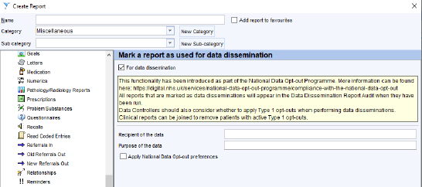
Both Emis and Systmone have updates to allow NDO registered patients to be removed from relevant searches.
Systmone Reports

Slide 22
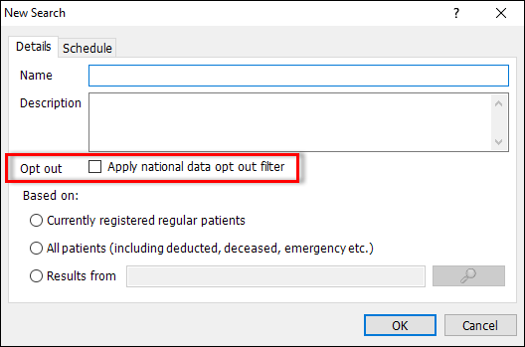
EMIS – Population Reporting

Slide 23

Any Questions?

